Slide 1
Setting up Raspbian
Mohammad Sabouri

Slide 2
Reference
https://learn.sparkfun.com/tutorials/setting-up-raspbian-and-doom

Slide 3
Introduction
The Raspberry Pi is a cross between a typical embedded system -- like an Arduino -- and a desktop computer. The Pi packs a 700MHz ARM11 Core with 512MB of RAM, HDMI and audio outputs, 2 USB ports, an Ethernet jack, and an SD socket with support for up to a 32GB SD card. In the eyes of some, it's one of the more powerful, cost-effective embedded boards to hit the market. To others, it's one of the most compact, bare-bones personal computers ever to grace the electronics world with it's presence. In either case, it's here to blur the line between the world of embedded electronics and personal computing.

Slide 4
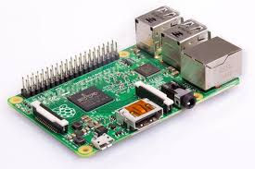
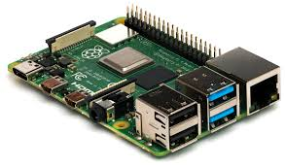
Raspberry Pi

